Slide 1

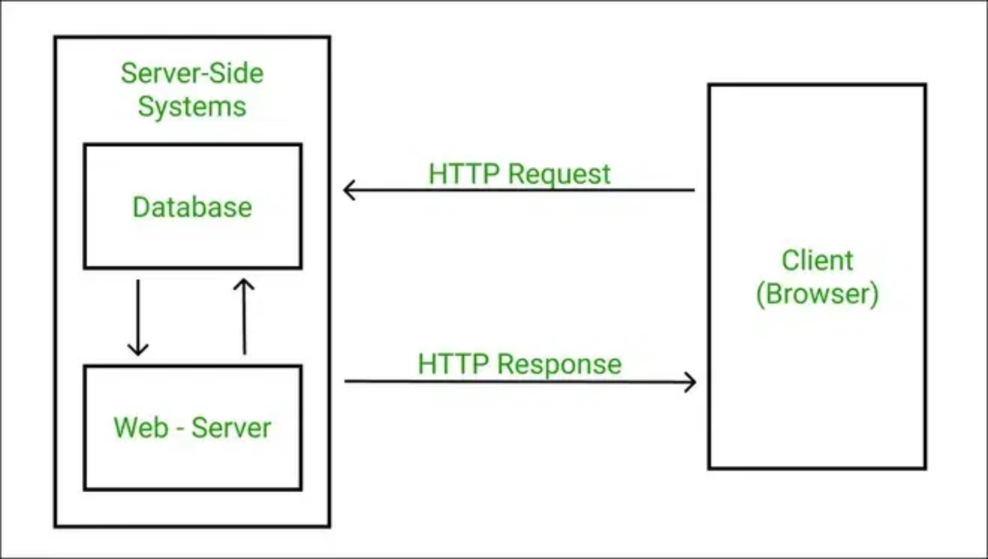
HTTP Fundamentals and Web Architecture
Understanding the Building Blocks of Web Communication
DA2402: Data Curation and Visualization

Slide 2

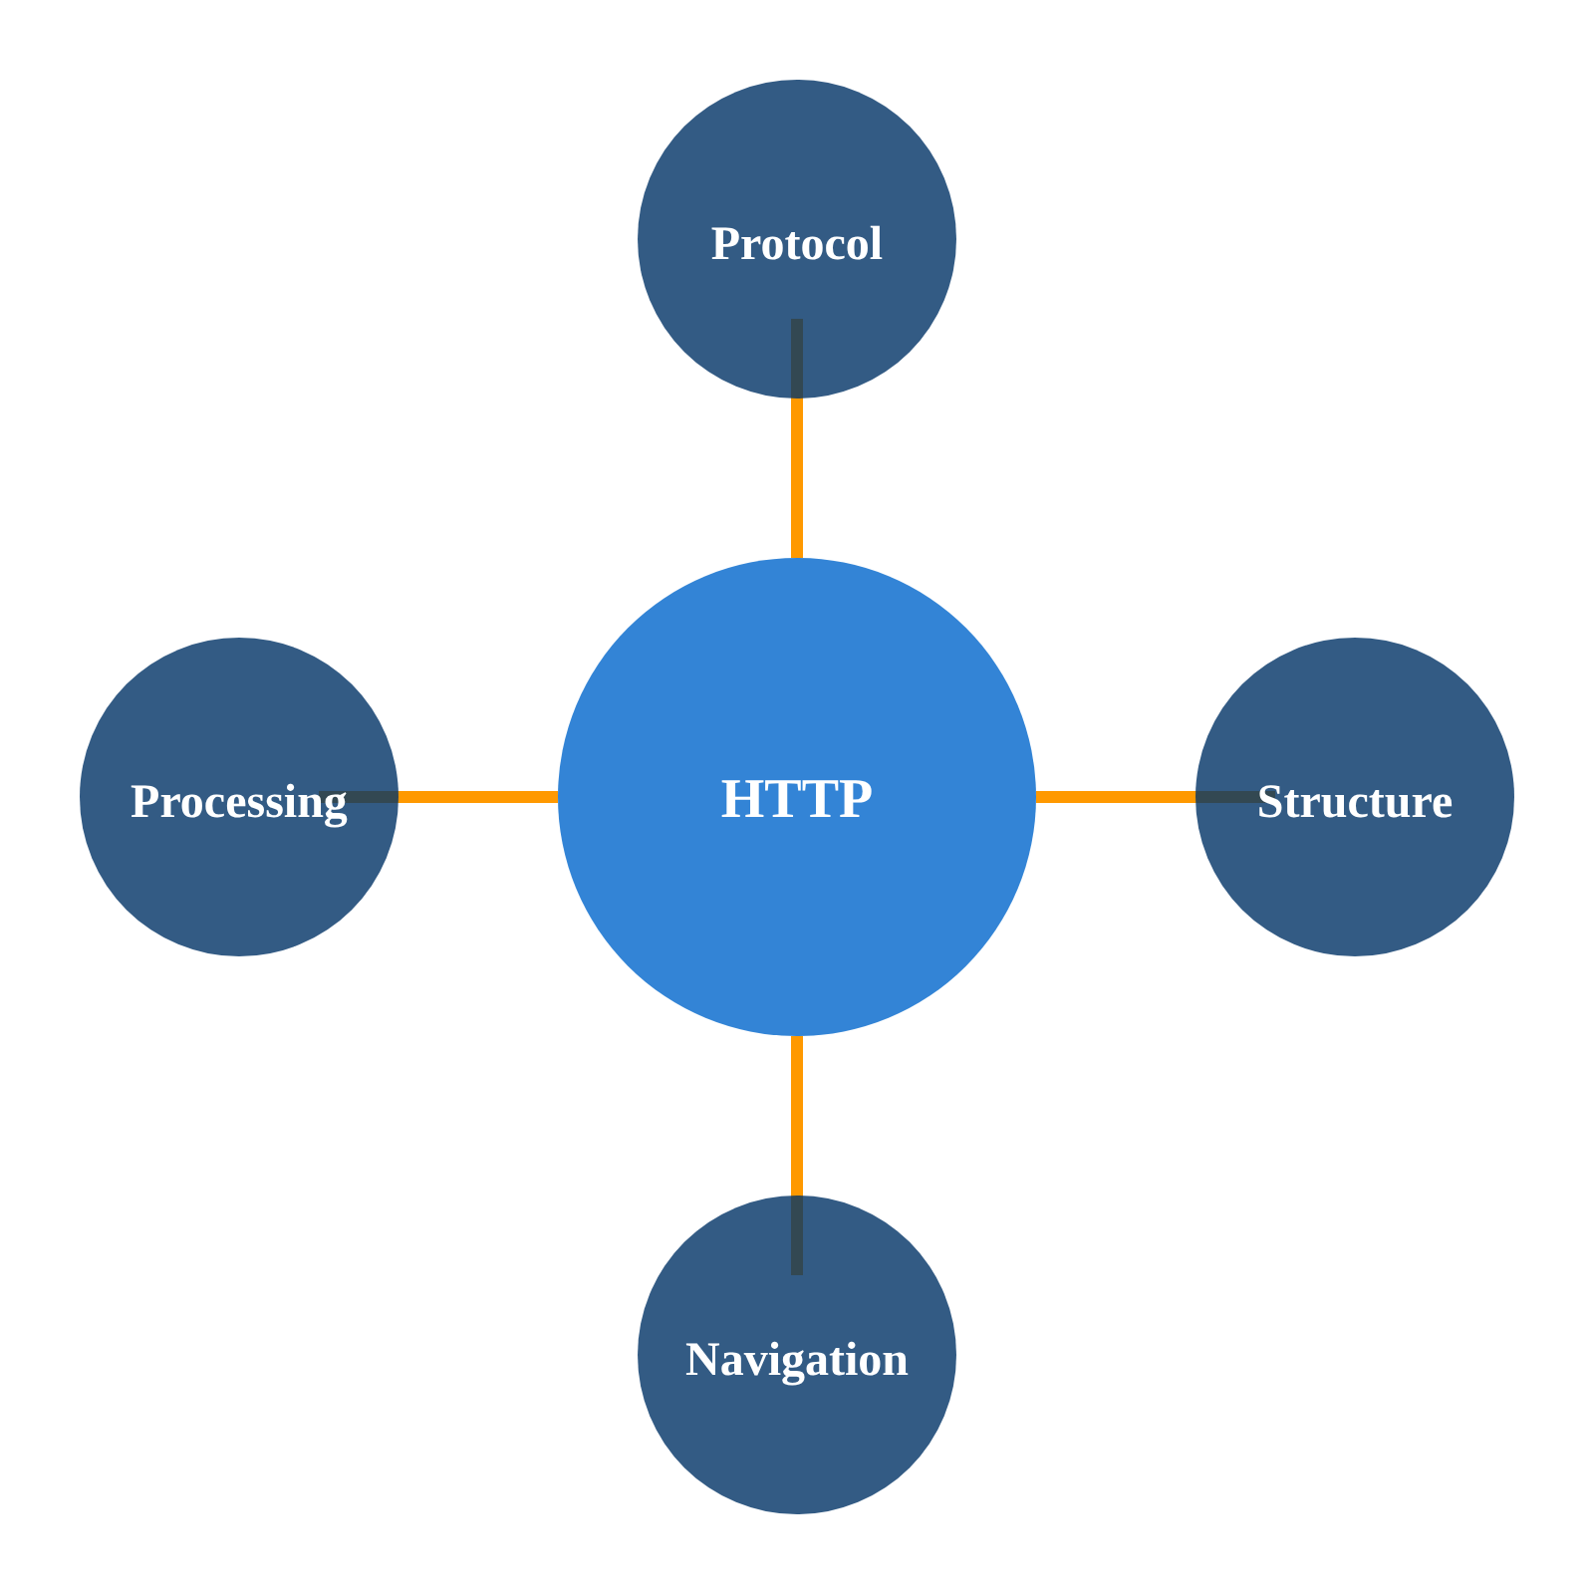
Learning Objectives
HTTP Protocol Mechanics
Understand the fundamentals of HTTP as a stateless protocol, its structure, and how it enables web communication
HTML/CSS Structure
Learn the structure of HTML documents, CSS styling principles, and how they work together to create web pages
Web Navigation Techniques
Master DOM navigation methods and techniques for traversing web page structures programmatically
Request/Response Processing
Develop skills in handling HTTP requests, processing responses, and working with different data formats
These skills form the foundation for effective web scraping and data collection

Slide 3

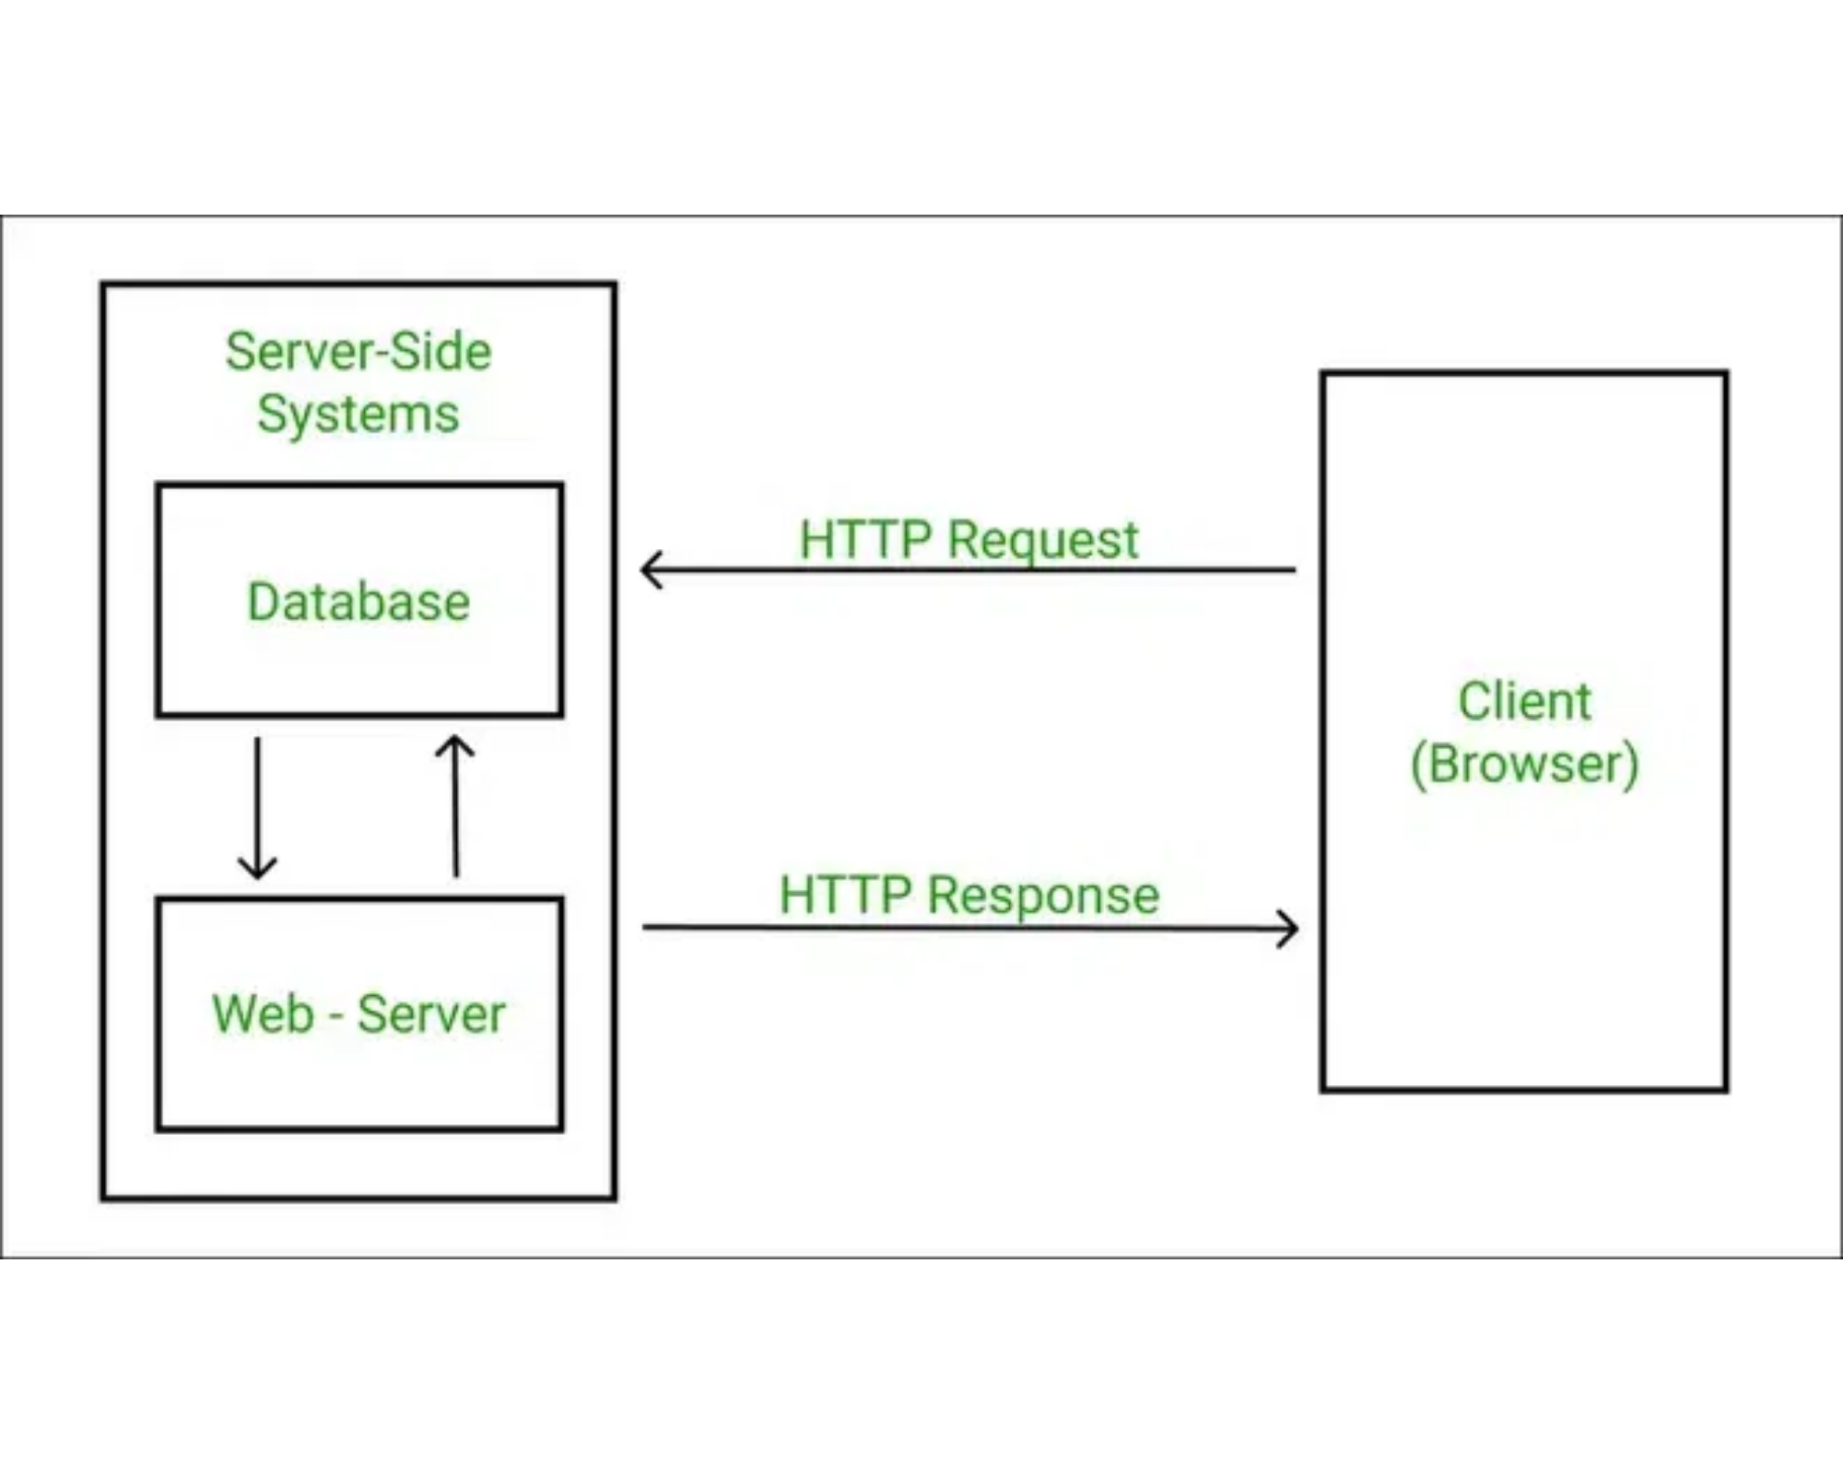
HTTP Protocol Basics
HTTP (Hypertext Transfer Protocol) is a stateless application-level protocol for distributed, collaborative, hypermedia information systems.
Key Characteristics
Stateless protocol - each request from client to server must contain all information needed to understand the request
Client-server architecture - separation of concerns between client (requesting resources) and server (providing resources)
Text-based - uses human-readable format for requests and responses
Connectionless - after a request is made and a response is received, the connection between client and server is closed
Versions
HTTP/1.1 - Introduced persistent connections
HTTP/2 - Added multiplexing and header compression
HTTP/3 - Uses QUIC protocol for improved performance
HTTP forms the foundation of data exchange on the World Wide Web

Slide 4

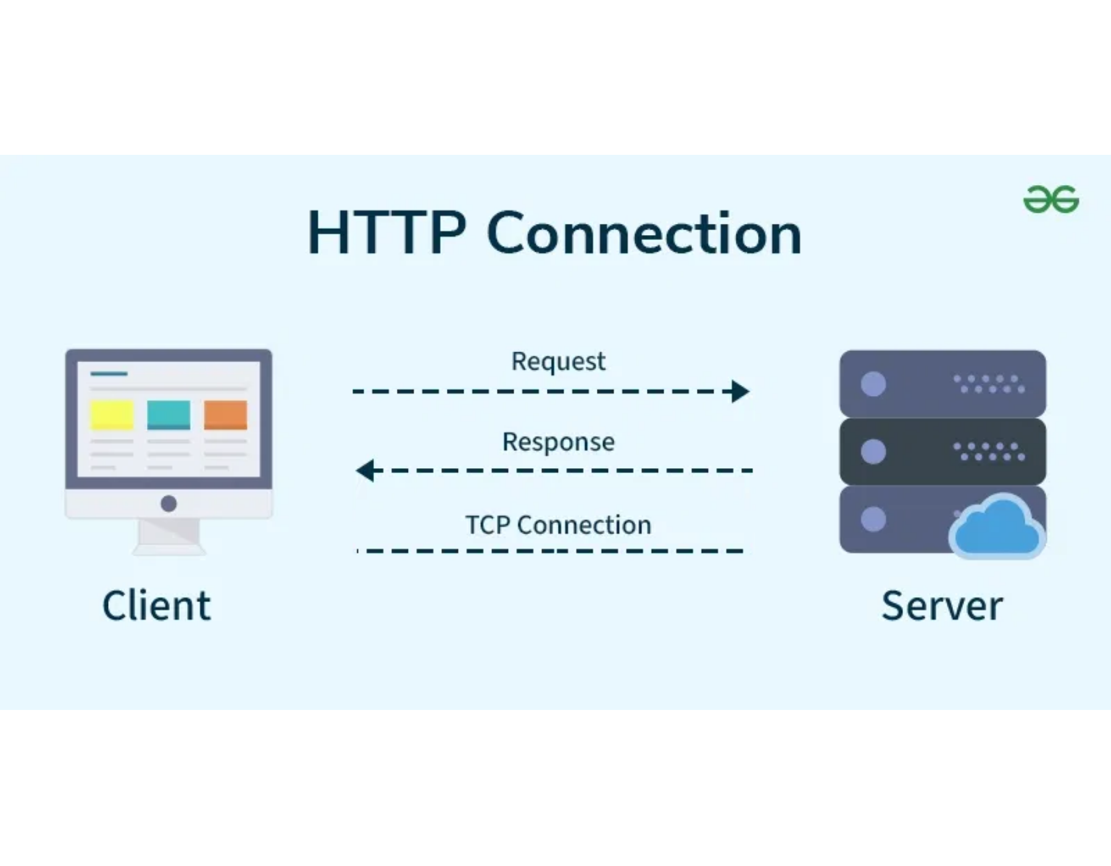
HTTP Request-Response Cycle
HTTP Request Components
Request Line
Method (GET, POST, etc.), URI, and HTTP version
Headers
Metadata about the request (Content-Type, User-Agent)
Body (optional)
Data sent to the server (form data, JSON, etc.)
HTTP Response Components
Status Line
HTTP version, status code (200, 404, etc.), and reason phrase
Headers
Metadata about the response (Content-Type, Content-Length)
Body (optional)
Requested resource content (HTML, JSON, image data)
# Example HTTP Request
GET /index.html HTTP/1.1
Host: www.example.com
Accept: text/html
Understanding the request-response cycle is fundamental for effective web scraping

Slide 5

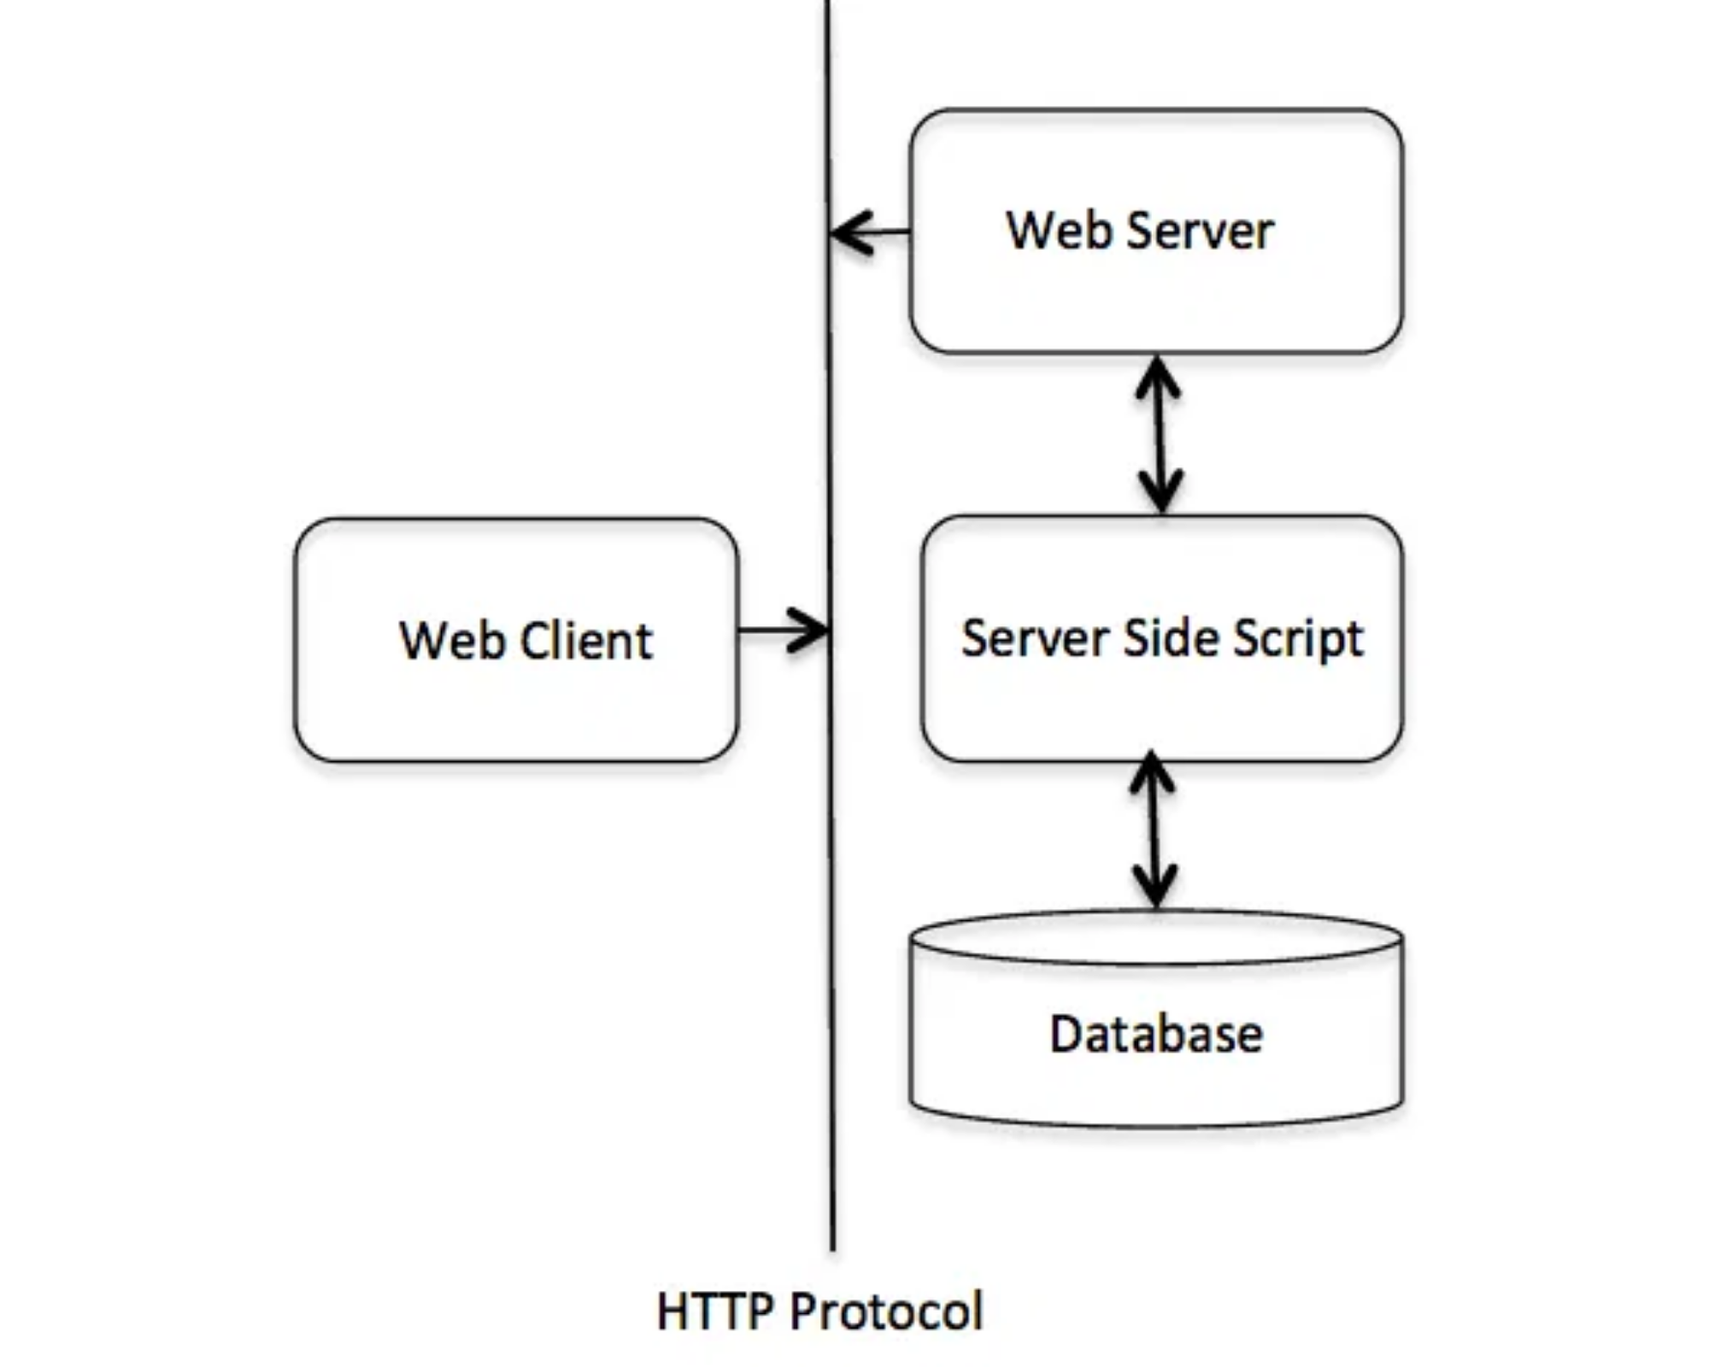
HTTP Methods
Common HTTP Methods
GET
Requests a representation of the specified resource. Requests using GET should only retrieve data and have no other effect.
POST
Submits data to be processed to the identified resource. The data is included in the body of the request.
PUT
Uploads a representation of the specified resource. Unlike POST, PUT is idempotent - calling it multiple times has the same effect.
DELETE
Deletes the specified resource. Also idempotent - multiple identical requests should have the same effect.
HEAD
Important for Web Scraping:
Most web scraping operations use GET
requests to retrieve page content. Understanding other methods is
essential when working with APIs or submitting forms.
HTTP methods define the desired action to be performed on the identified resource

Slide 6

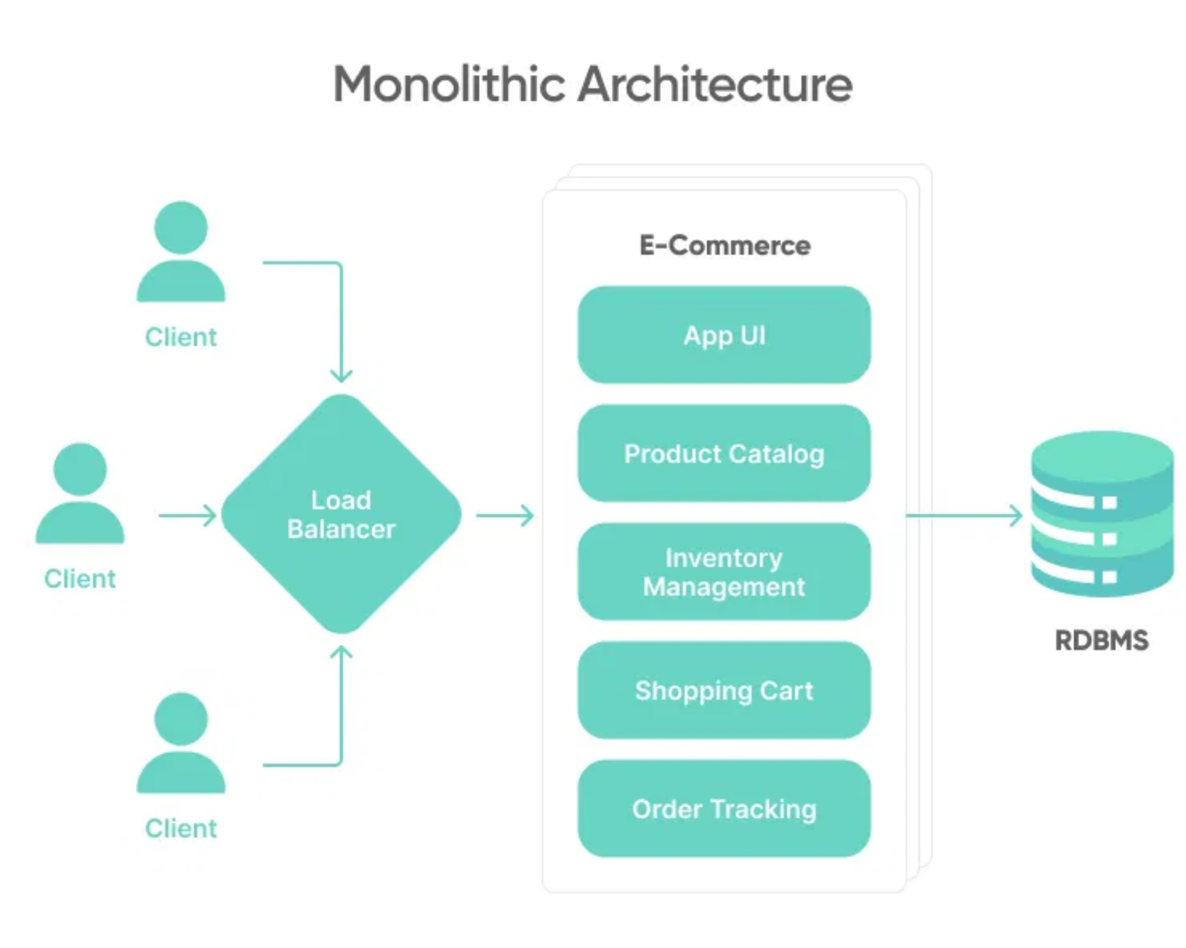
Web Architecture Overview
Key Components
Client Side
Web browsers, mobile apps, or any user agent that initiates requests and renders responses
Server Side
Web servers, application servers, and databases that process requests and deliver responses
Communication Layer
HTTP/HTTPS protocols that facilitate client-server communication
Infrastructure
DNS, load balancers, CDNs, and other systems that support web operations
Key Insight:
Understanding web architecture is essential for
effective web scraping, as it helps identify the optimal points for
data extraction and the proper methods for interacting with web
resources.
Modern web architecture continues to evolve with new technologies and patterns

Slide 7

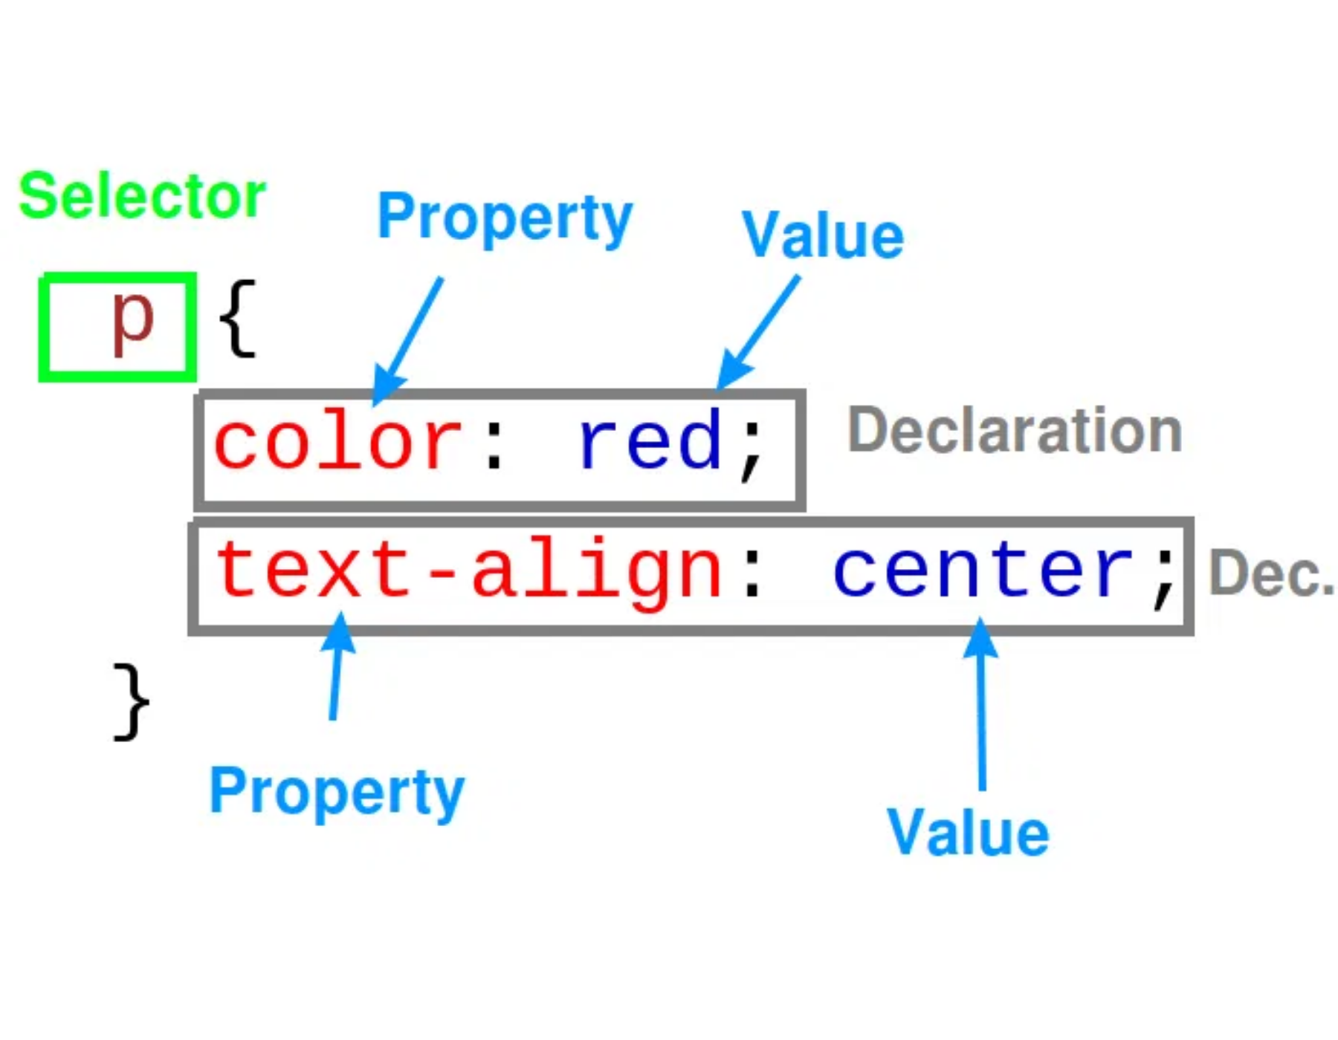
HTML/CSS Structure
HTML Document Structure
HTML defines the structure and content of web pages
<!DOCTYPE html>
<html>
<head>...</head>
<body>
<header>...</header>
<main>...</main>
<footer>...</footer>
</body>
</html>
CSS Styling
CSS controls the presentation and layout of HTML elements
selector {
property: value;
}
CSS selectors: element (div), class (.name), ID (#name)
Understanding HTML/CSS structure is essential for effective web scraping

Slide 8

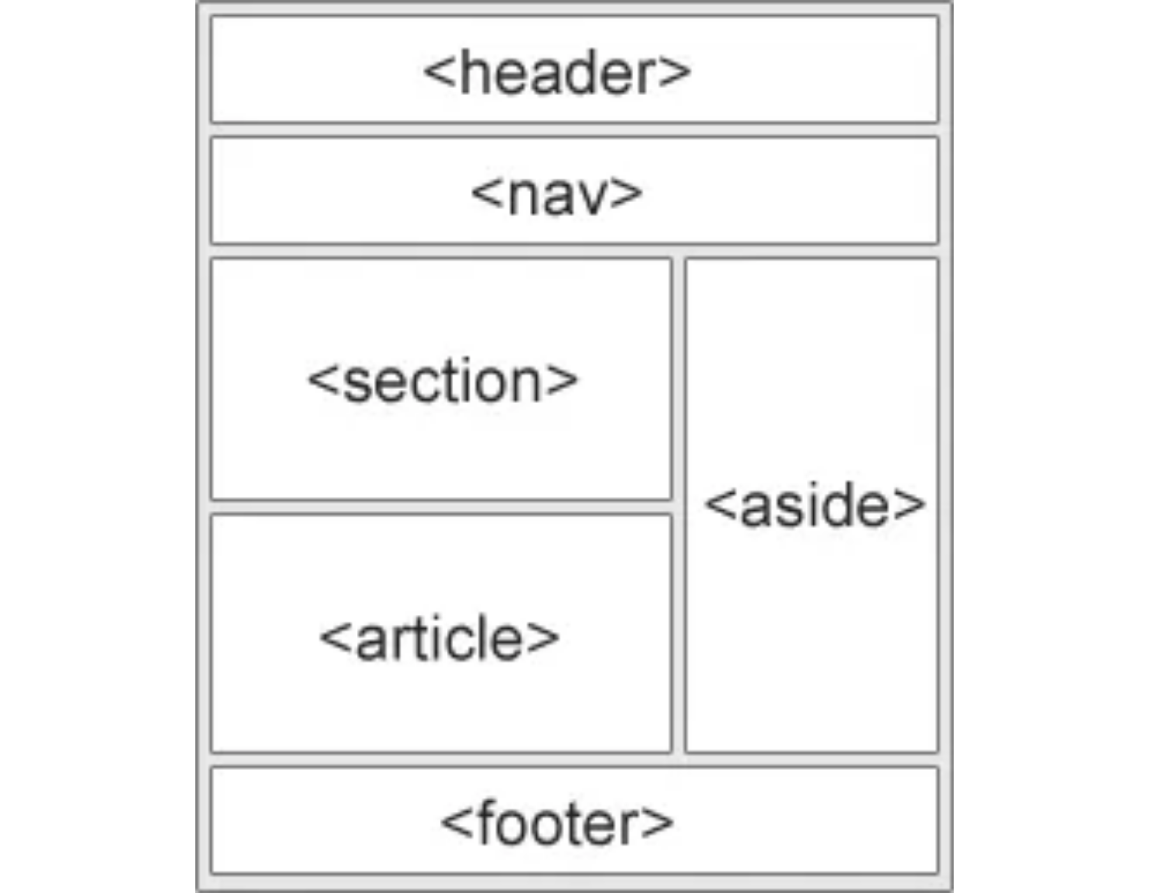
DOM Navigation Techniques
Navigating the Document Object Model
Element Selection
document.getElementById('main')
document.querySelector('.container')
Traversal Methods
element.parentNode
element.children
CSS Selector Navigation
document.querySelectorAll('nav a')
Content Extraction
element.textContent
element.getAttribute('href')
Effective DOM navigation is essential for extracting structured data from web pages

Slide 9

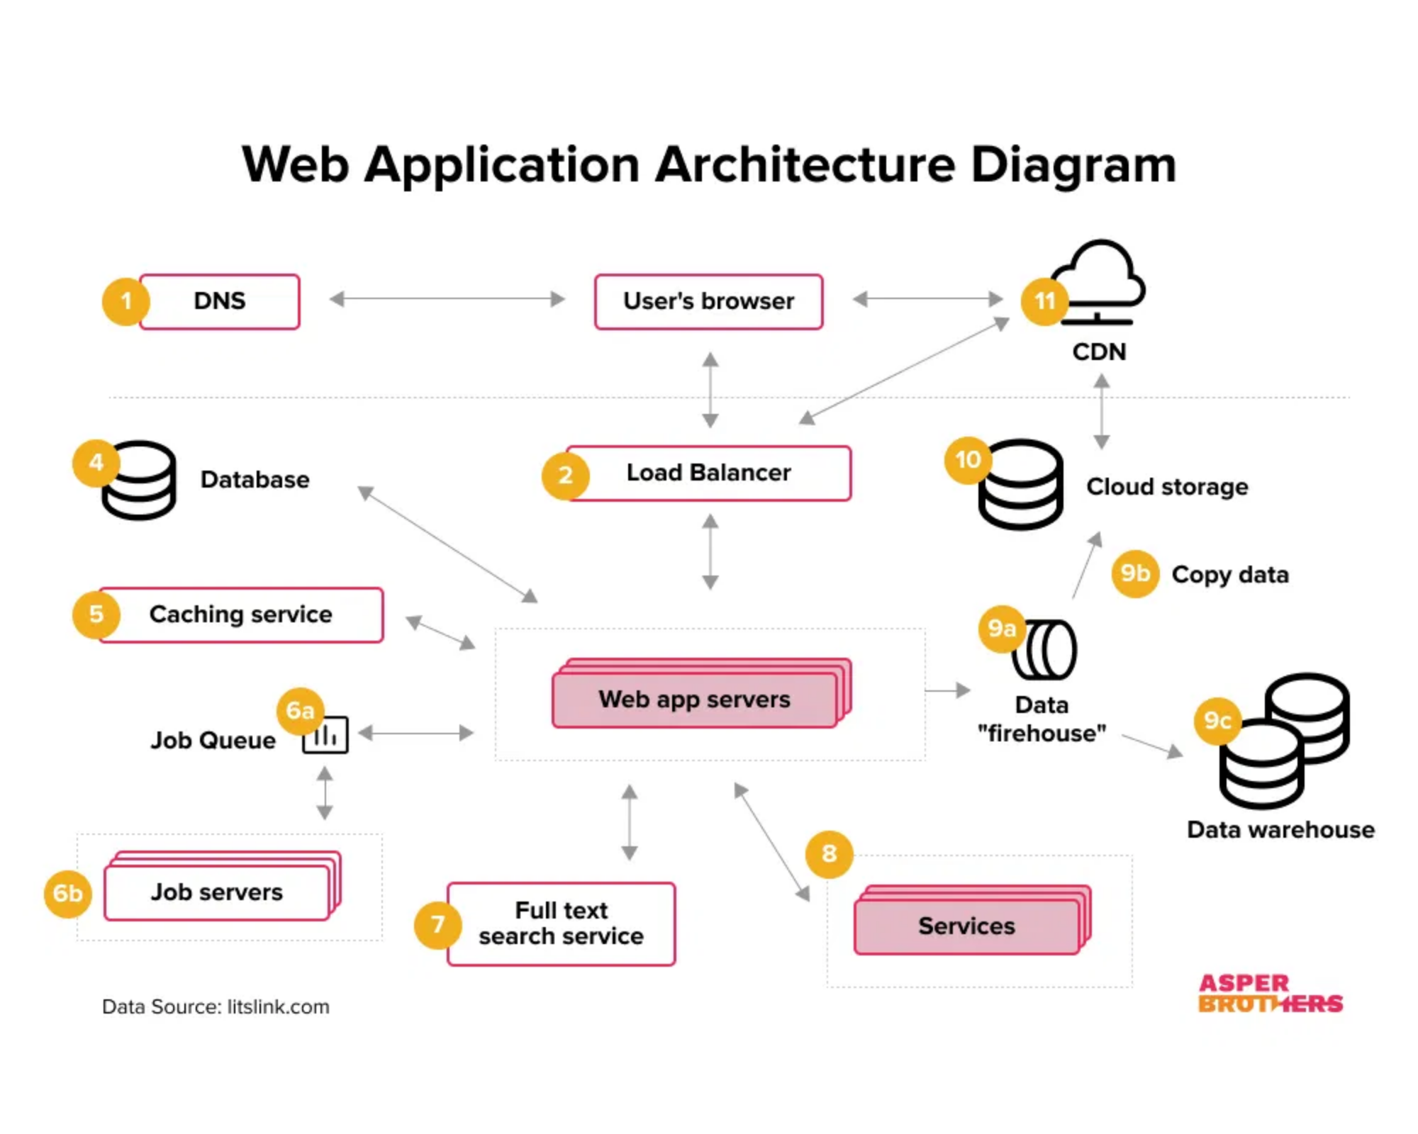
Request Handling & Processing
HTTP Request Handling Process
1
Request Formation
Constructing proper HTTP requests with appropriate headers
headers = {
'User-Agent': 'Mozilla/5.0...',
'Accept': 'text/html,application/json'
}
2
Response Parsing
Processing received data based on content type
if response.headers['Content-Type'] == 'application/json':
data = response.json()
else:
html = response.text
3
Error Handling
Managing different HTTP status codes and exceptions
if response.status_code == 200:
# Process successful response
elif response.status_code == 404:
# Handle not found error
Best Practice:
Implement rate limiting and respect robots.txt directives
when scraping websites to avoid being blocked and to be a good web
citizen.
Effective request handling is crucial for reliable data extraction and web scraping

Slide 10
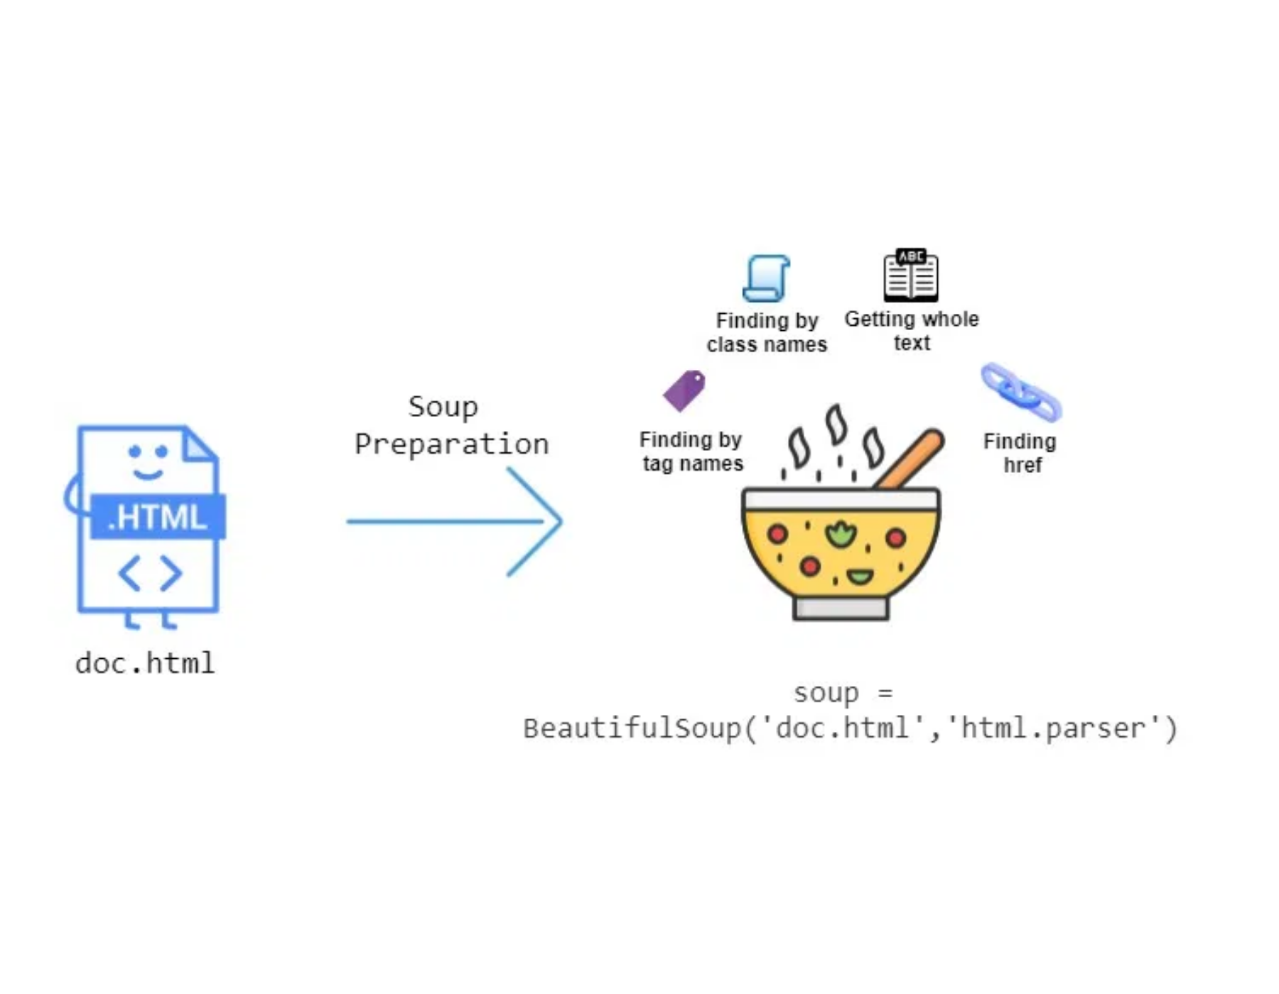
BeautifulSoup: DOM Parsing in Python
BeautifulSoup is a Python library that creates a parse tree from HTML and XML documents, providing simple methods to navigate, search, and modify the DOM structure.
Creating a Soup Object:
Parse HTML into a DOM tree
from
bs4
import
BeautifulSoup
# From a string
html_doc
"""<html><head><title>Example</title></head>
<body><h1>Hello World</h1><p class="content">Paragraph</p></body></html>"""
=
soup
=
BeautifulSoup
(
html_doc
,
'lxml'
)
# From a file
with
open
(
'example.html'
)
as
f
:
soup
=
BeautifulSoup
(
f
,
'lxml'
)
BeautifulSoup provides a Pythonic interface to the DOM, making web scraping intuitive and efficient

Slide 11

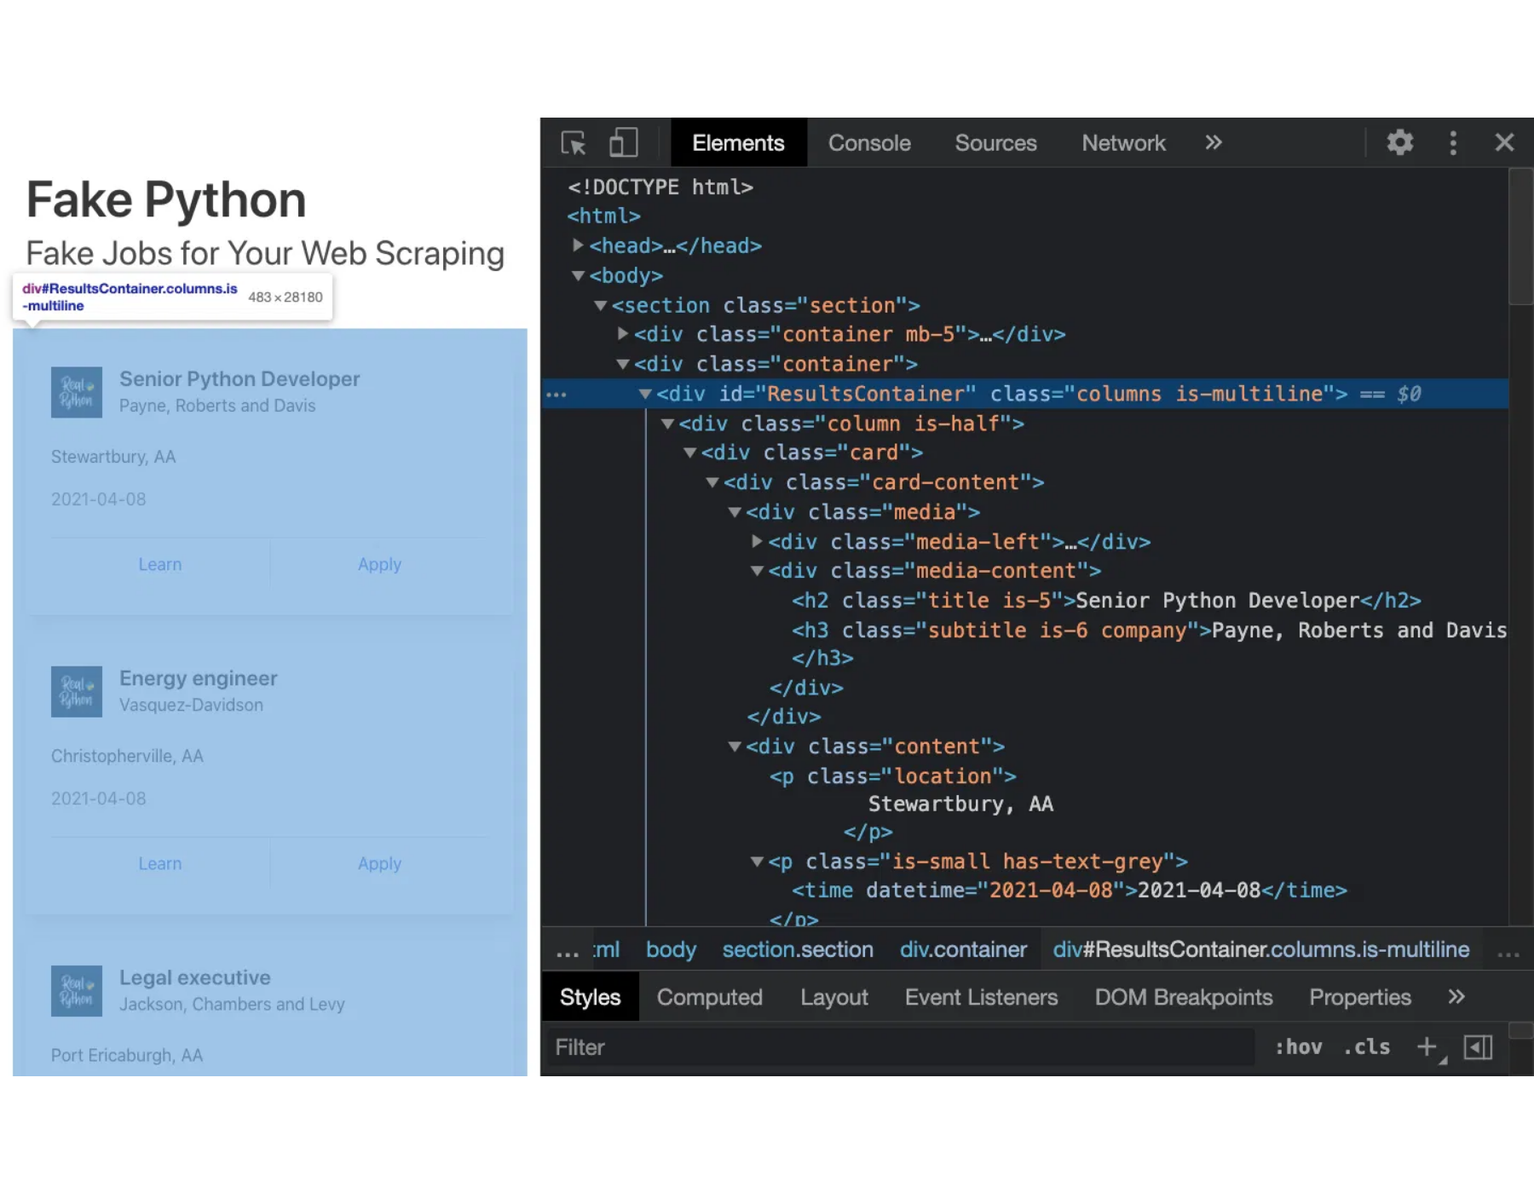
DOM Navigation with BeautifulSoup
Finding Elements
Direct Element Access
# Find first occurrence
soup
.
find
(
'h1'
)
# First h1 element
soup
.
h1
# Same as above
# Find all occurrences
soup
.
find_all
(
'p'
)
# All p elements
CSS Selector Methods
soup
(
'p'
)
# Same as above
# CSS selectors (similar to querySelector)
soup
.
select
(
'div.content'
)
# div with class 'content'
soup
.
select
(
'#main p'
)
# p elements inside #main
soup
.
select
(
'ul > li'
)
# direct li children of ul
DOM Tree Navigation
Parent, Children, and Siblings
# Parent navigation
element
.
parent
# Direct parent
element
.
parents
# All ancestors (iterator)
# Child navigation
element
.
contents
# Direct children as list
BeautifulSoup's navigation methods mirror DOM relationships, making tree traversal intuitive
element
.
children
# Direct children (iterator)
# Sibling navigation
element
.
next_sibling
# Next sibling
element
.
previous_sibling
# Previous sibling

Slide 12

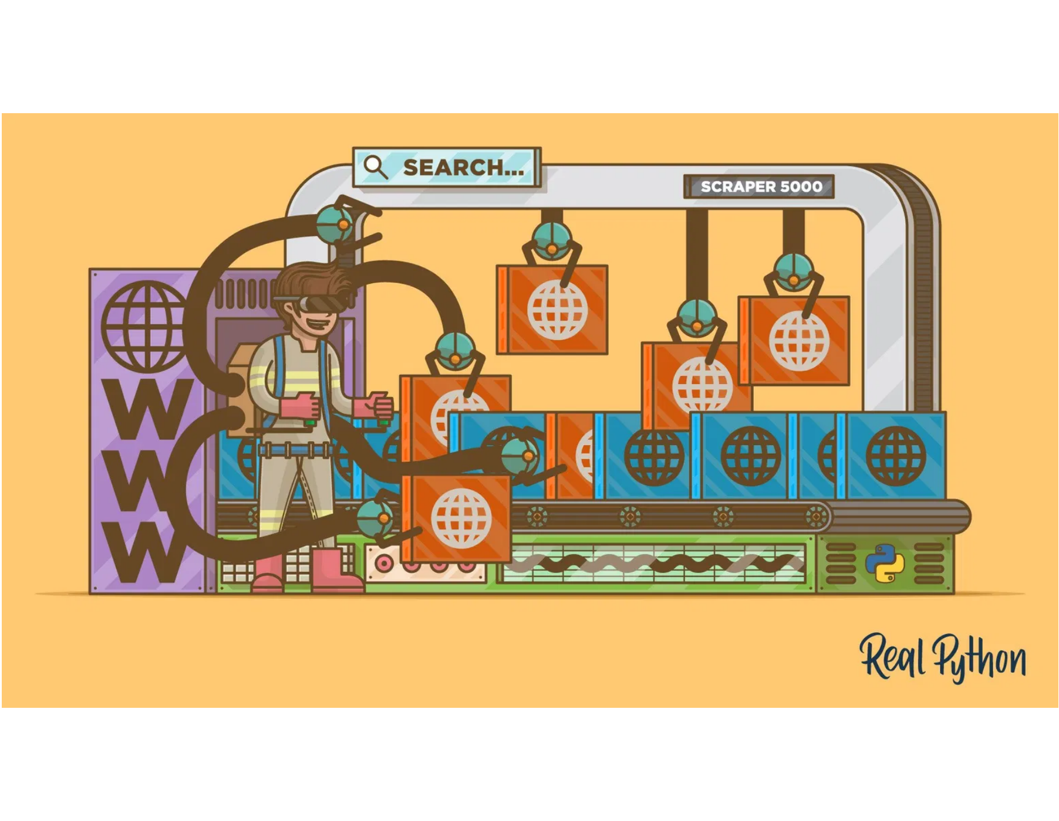
Data Extraction Techniques
Content Extraction
Text and Attribute Extraction
# Text extraction
element
.
text
# Get visible text
element
.
get_text
(
)
# With more options
# Attribute extraction
element
[
'href'
]
# Get attribute value
Practical Examples
element
.
get
(
'class'
)
# Safe attribute access
element
.
attrs
# All attributes as dict
Extracting Table Data
# Extract data from a table
table
=
soup
.
find
(
'table'
)
rows
=
[
]
for
tr
in
table
.
find_all
(
'tr'
)
[
1
:
]
:
# Skip header
row_data
=
[
td
.
text
.
strip
(
)
for
td
in
tr
.
find_all
(
'td'
)
]
rows
.
append
(
row_data
)
Extracting Product Information
# Convert to pandas DataFrame
# Extract product information
import
pd
df
pandas
as
products
=
[
]
=
pd
.
DataFrame
(
rows
,
columns
=
[
'Name'
,
'Price'
,
'Rating'
]
)
for
item
in
soup
.
select
(
'.product-item'
)
:
name
=
item
.
select_one
(
'.product-name'
)
.
text
.
strip
(
)
price
=
item
.
select_one
(
'.price'
)
.
text
.
strip
(
)
url
=
item
.
select_one
(
'a'
)
[
'href'
]
Best Practice:
Always use error handling and validation when scraping websites, as
products
.
append
(
{
'name'
:
name
,
'price'
:
price
,
'url'
:
url
}
)
HTML structure can change unexpectedly.
BeautifulSoup makes data extraction straightforward by providing intuitive methods to access DOM content

Slide 13

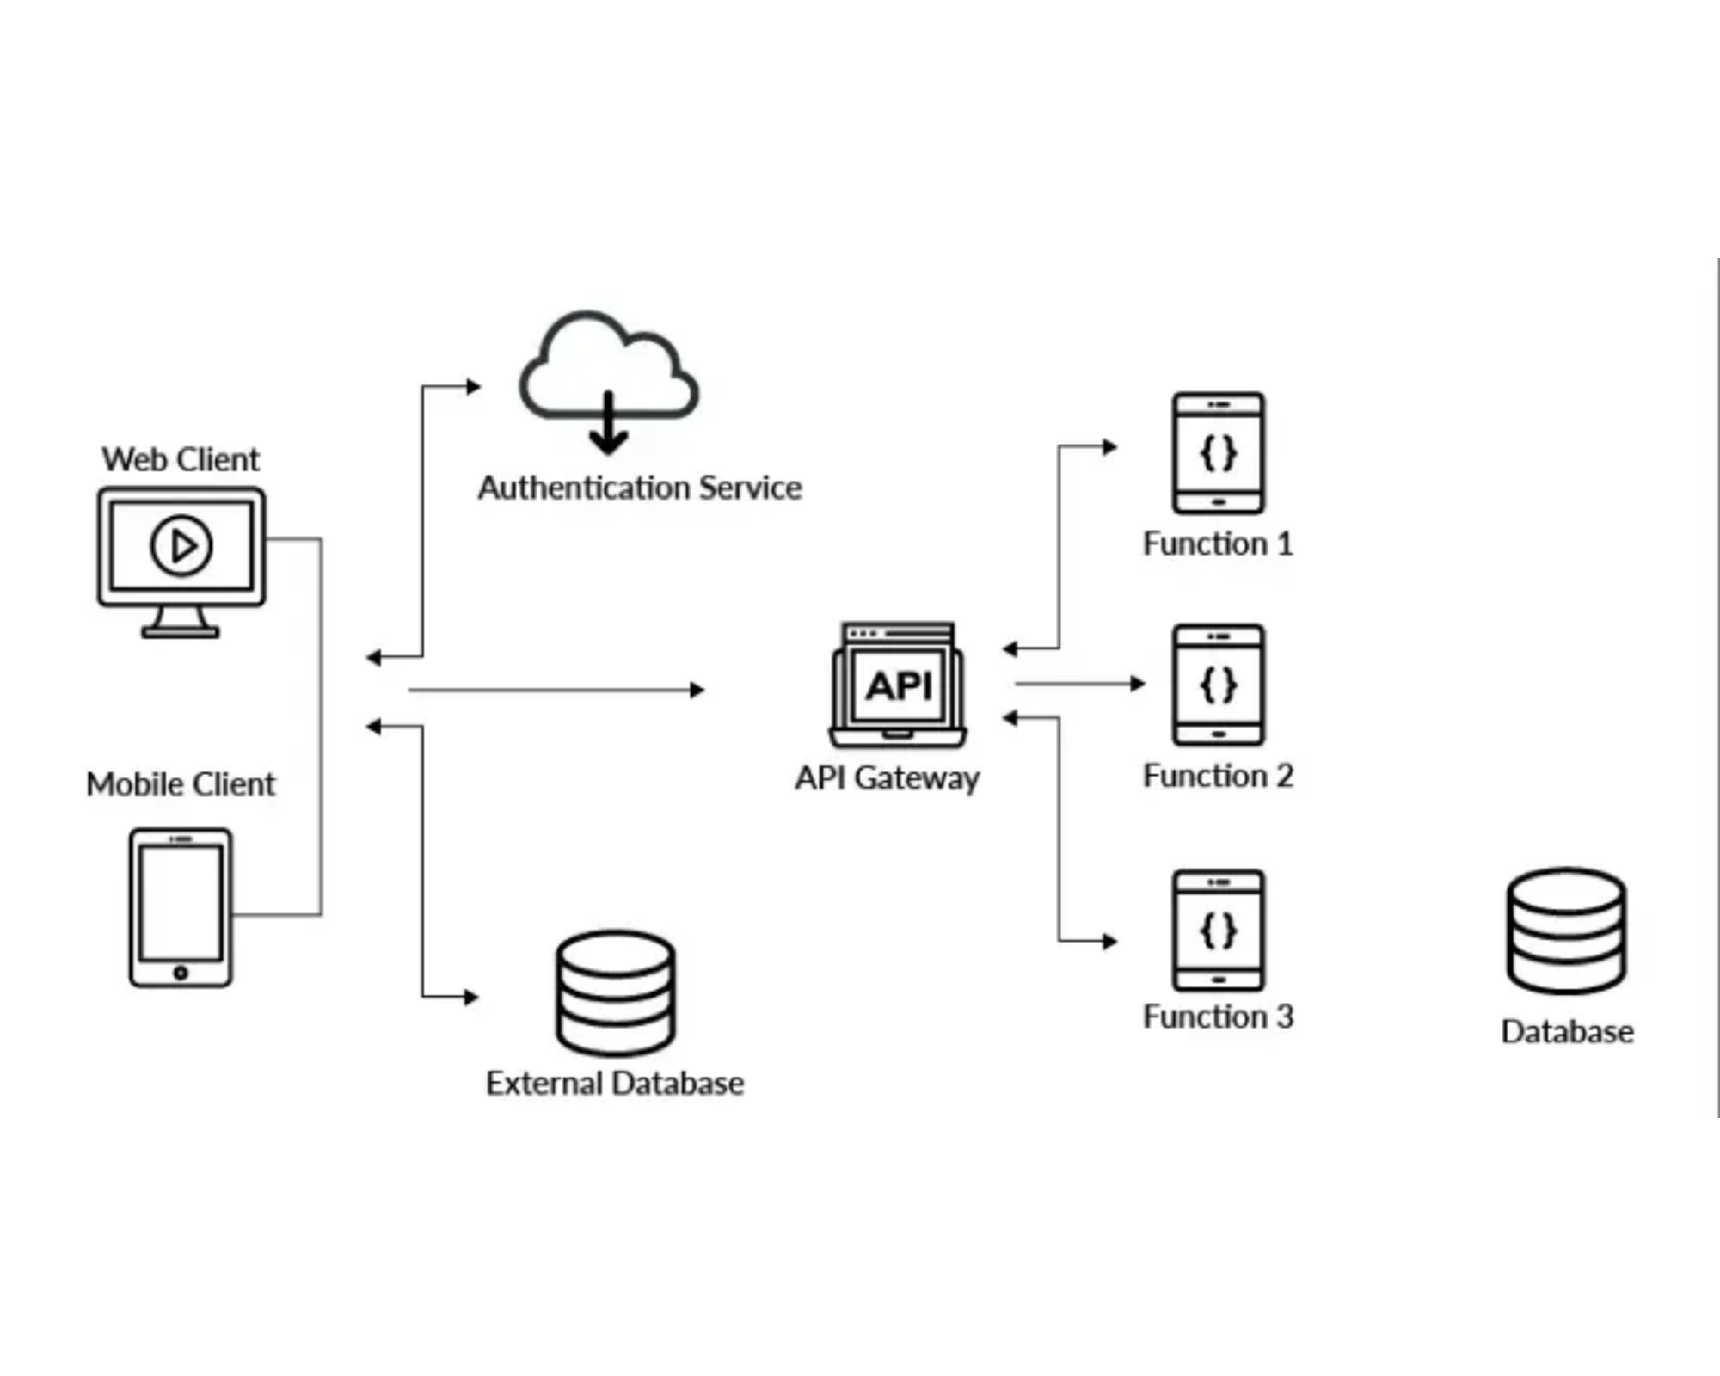
Practical Applications
Real-World Applications of HTTP Fundamentals
Web Scraping
Extracting structured data from websites for analysis, monitoring, or integration with other systems
API Integration
Connecting to web services and APIs to retrieve or submit data programmatically
Data Collection & Analysis
Gathering data from multiple sources for research, business intelligence, or competitive analysis
Automation
Creating bots and scripts to automate repetitive web tasks and workflows
Best Practices:
Always respect robots.txt files, implement rate limiting,
add proper user-agent headers, and follow ethical scraping guidelines to
avoid overloading servers or violating terms of service.
Understanding HTTP fundamentals enables effective data collection and integration across the web

